Slide 1
EE2331 Data Structures and Algorithms
Trees: binary tree, operations

Slide 2
Binary Tree

Slide 3
Binary Trees
Definition: each node has at most 2 children (left and right)
i.e. the node in binary tree should have either no children (leaf node), 1 child or 2 children
Feature:
A special kind of tree
Simple design
Fixed max. degree of each node
Easier to represent with fixed data structure
Easy

Slide 4
Are They Binary Tree? Why?
A
Tree 1
A
Tree 2
A
Tree 3
B
C
D
B
C
B
E
F
G
H
I
D
E
F
C
J
K
L
M
G
H
A
Tree 4
A
Tree 5 (root only)
Tree 6 (empty tree)
B
C
D
E
F
G
Notes:
Only tree 1 is not binary tree

Slide 5
Types of Binary Tree
Skewed tree
All nodes are either on the left hand side or right hand side
A
root
A
root
B
B
C
leaf
C
leaf

Slide 6
Types of Binary Tree
Full binary tree is a tree in which every node in the tree has either 0 or 2 children.
root
A
B
C
D
E
F
G

Slide 7
Types of Binary Tree
A
root
Complete binary tree is a tree in which every level, except possibly the last, is completely filled, and all nodes are as far left as possible.
It can have between x and y nodes at the last level m.
B
C
D
E
F
G
What is the range of the number of nodes at the last level m?
H
I
Notes:
X=1, y=2^{m-1}

Slide 8
Types of Binary Tree
Perfect binary tree is a binary tree in which all interior nodes have two children, and all leaves have the same depth or same level.
Perfect binary tree is also full binary tree and complete binary tree.
A
B
C
D
E
F
G
Given a perfect binary tree T of height h, how many nodes does T have?

Slide 9
Formation of Binary Trees
It contains 3 parts, namely
root node, left subtree, right subtree
For each subtree, it has 3 parts again (recursive definition)
A
root
Left
subtree
Right
subtree

Slide 10
Properties of Binary Trees
Maximum no. of nodes on level m is 2^{m-1}
Maximum no. of nodes is 2^{h+1} - 1, where h is the height of the tree
Can you convince yourself by proving the above?

Slide 11
Counting Binary Trees
How many different combination of a tree can have if it has n nodes?
For n = 1, only one combination
A
root

Slide 12
Counting Binary Trees
For n = 2, two combinations
A
root
A
root
B
B
Note: they are different!

Slide 13
Counting Binary Trees
For n = 3, five combinations
A
root
A
root
A
root
B
B
B
A
root
C
C
C
B
A
root
C
B
C

Slide 14
Counting Binary Trees
For n = 4, 14 combinations
Try yourself
For n = k, combinations

Slide 15
Array Implementation for binary tree (BT)

Slide 16
Array Implementation
Depth
A
0 (array index)
0
B
1
C
2
1
D
3
E
4
F
5
G
6
2
H
7
I
8
The nodes are numbered in level order.
3
array:
[0]
[1]
[2]
[3]
[4]
[5]
[6]
[7]
[8]
A
B
C
D
E
F
G
H
I
Depth:
0
1
2
3

Slide 17
Array Implementation
Depth
(keep the array size same as the tree on page 3)
A
0
0
B
1
C
2
1
3
D
4
E
5
6
2
Still reserve the spaces for empty nodes
7
8
3
array:
[0]
[1]
[2]
[3]
[4]
[5]
[6]
[7]
[8]
A
B
C
-
D
E
-
-
-
Depth:
0
1
2
3

Slide 18
Array Implementation
Depth
A
0
A
0
0
B
1
B
2
1
These 2 trees are different! (see the array content)
C
3
C
6
2
array:
[0]
[1]
[2]
[3]
[4]
[5]
[6]
[7]
[8]
A
B
-
C
-
-
-
-
-
A lot of unused space for non-complete binary tree
array:
[0]
[1]
[2]
[3]
[4]
[5]
[6]
[7]
[8]
A
-
B
-
-
-
C
-
-

Slide 19
Indicating Unused Nodes
Method 1:
array:
A
B
-
C
-
-
-
-
-
Assign a special or invalid value (e.g. -1, ‘\0’)
Method 2:
array:
A
B
?
C
?
?
?
?
?
Create another boolean array to indicate the unused node
additional array:
1
1
0
1
0
0
0
0
0

Slide 20
Memory Efficiency
For complete binary tree, array implementation is a very good approach
Simple
Utilize the memory very well
But for other binary trees
Much memory has been wasted

Slide 21
In-class exercise
For a binary tree of height h, what is the smallest tree, plot it (sketch the key topology)
For a binary tree of height h, what is the largest tree, plot it (sketch the key topology)

Slide 22
Depth and node number
Depth. # nodes
A
0 (array index)
0 2⁰
B
1
C
2
1 2¹
D
3
E
4
F
5
G
6
2 2²
H
7
I
8
3 <= 2³
The total number of nodes for depth 0 to depth 2: 1+2+4
Generally, 2⁰+2¹+2² + … + 2^{d} = 2^{d+1} -1

Slide 23
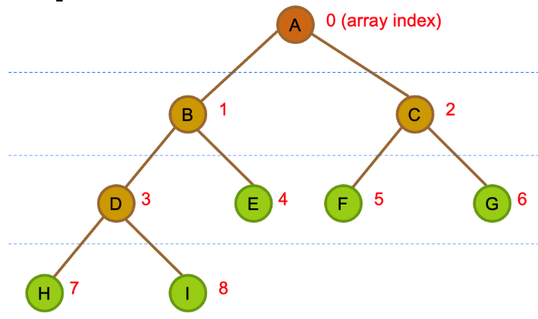
Determine the Index of Children
If the array index of node x is n, what are the array indexes of the children of node x (i.e. node y and z)?
X
n
Y
?
Z
?
array index:
n-1
n
2n+1
2n+2
…
X
…
Y
Z
…
Notes:
Left: 2n + 1
Right: 2n + 2

Slide 24
How to prove it?
Hint: let a node be the ith node at depth d, now figure out its index and also its left child’s index.

Slide 25
Determine the Index of Parent
If the array index of node x is n, what is the array index of the parent of node x (i.e. node w)?
W
?
W
?
X
n
X
n
array index:
(n-1)/2
n
…
W
…
X
…
Notes:
Parent: (n-1)/2

Slide 26
Left or Right Child?
If the array index of node x is n, how to determine if node x is the left child or right child?
W
?
W
?
X
n
X
n
left child if n is odd
if (n % 2 == 1) { /* left */ }
right child if n is even
if (n % 2 == 0) { /* right */ }

Slide 27
Linked List Implementation

Slide 28
Linked List Implementation
template<class Type>
struct treeNode {
Type info;
treeNode<Type> *left, *right;
}; //treeNode<int> *root;
struct treenode{
int info;
treenode *left, *right;
} //only work for int info field
root
A
left
info
right
A
root
B
C
B
C
left
info
right
left
info
right
D
E
D
E
NULL indicating no subtrees
left
info
right
left
info
right
Notes:
https://www.cplusplus.com/doc/oldtutorial/templates/
If you have trouble understanding the template, just think Type as int or string, which is the type for the information field.

Slide 29
Possible Variations
root
A
left
info
parent
right
B
C
left
info
parent
right
left
info
parent
right
…
…
…
…
Each node has 3 references:
left, right and parent

Slide 30
Common Operations

Slide 31
Compute the Height
template<class Type>
int height(treeNode<Type> *tree)
{
if (tree == NULL)
return -1; // some definitions of empty tree’s height = 0
if ((tree->left == NULL) && (tree->right == NULL))
return 0;
int HL = height(tree->left);
int HR = height(tree->right);
if (HL > HR)
return 1+HL;
else
return 1+HR;
}
Height of root = max(1 + h_{left} , 1 + h_{right})
p
Left
subtree
right
subtree
Height of left subtree = h_{left}
Height of right subtree = h_{right}

Slide 32
Count No. of Nodes / Leaves
template<class Type>
int nodeCount(treeNode<Type> *tree) {
if (tree == NULL)
return 0;
return 1 + nodeCount(tree->left) + nodeCount(tree->right));
}
template<class Type>
int leavesCount(treeNode<Type> *tree) {
if (tree == NULL)
return 0;
else if ((tree->left == NULL) && (tree->right == NULL))
return 1;
else
return leavesCount(tree->left) + leavesCount(tree->right);
}

Slide 33
Copy Binary Tree
template<class Type>
treeNode<Type>* copyTree_2(treeNode<Type> *other)
{
if (other == NULL)
return NULL;
treeNode<Type> *p = new treeNode<Type>;
p->info = other->info;
p->left = copyTree_2(other->left);
p->right = copyTree_2(other->right);
return p;
}

Slide 34
Compare Two Binary Tree
The two binary trees are identical iff
Their root nodes are equal;
their left subtrees are equal and;
their right subtrees are equal.
template<class Type>
bool equal(treeNode<Type> *tree1, treeNode<Type> *tree2) {
if ((tree1 == NULL) && (tree2 == NULL))
return true;
if ((tree1 != NULL) && (tree2 != NULL)) {
if ((tree1->info == tree2->info) &&
equal(tree1->left, tree2->left) &&
equal(tree1->right, tree2->right))
return true;
}
return false;
}

Slide 35
Printing a Binary Tree
4
8
2
3
5
Right most node
3
root
5
8
root
Left most node
2
4

Slide 36
Printing a Binary Tree
Print the right subtree first
Try to modify the code to
print out the left subtree
first.
#include <iomanip> //setw(), set width
template<class Type>
void printTree(treeNode<Type> *p, int indent) {
if (p != NULL) {
//print right subtree, root, and then left subtree
printTree(p->right, indent+3);
cout << setw(indent) << p->info << endl;
printTree(p->left, indent+3);
}
}

Slide 37
Four Basic Traversal Orders
Describe the way to visit every nodes of the entire tree
Level order
visit the nodes from left to right, level by level starting from the root
Breadth first traversal
Or
Breadth first
Search (BFS)
A
0
B
1
C
2
D
3
E
4
F
5
G
6
H
7
I
8
Notes:
Queue can be used for breadth first traversal

Slide 38
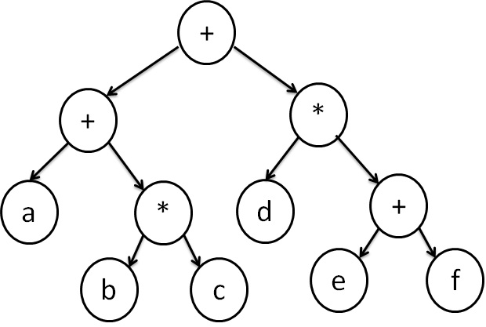
Other traversal orders
What is the expression/formular represented by this tree?
(a+b*c)+(d*(e+f))
+ (+a(*(bc)))(*(d)(+ef))
expression tree

Slide 39
Four Basic Traversal Orders
Preorder
visit the root (V)
visit the left subtree in preorder (L)
visit the right subtree in preorder (R)
Inorder
visit the left subtree in inorder (L)
visit the root (V)
visit the right subtree in inorder (R)
Postorder
visit the left subtree in postorder (L)
visit the right subtree in postorder (R)
visit the root (V)
Depth first traversal
(Depth first search (DFS))
Notes:
Stack can be used for depth first traversal

Slide 40
Example: LVR
Step i) go to left subtree (recursion)
Step ii) visit node x
Step iii) go to right subtree (recursion)
5
ii
visit
X
A
1
4
B
C
2
3
Left
subtree
right
subtree
i
iii
traverse
traverse
Trivial case:
BAC

Slide 41
Inorder Traversal
LVR
root
A
B
C
D
E
F
What is the order of traversal?
G
H

Slide 42
Inorder Traversal
Start from root
root
Traversal order: BAC
A
But B is the root of a subtree
B
C
D
E
F
G
H

Slide 43
Inorder Traversal
Start from root
root
Traversal order: BAC
A
Traversal order: DBE
B
2
C
D
1
E
F
G
H

Slide 44
Inorder Traversal
Start from root
root
Traversal order: BAC
A
Traversal order: DBE
B
2
C
D
1
E
4
F
Traversal order: GEH
G
3
H
5

Slide 45
Inorder Traversal
Start from root
root
Traversal order: BAC
A
6
B
2
C
D
1
E
4
F
G
3
H
5

Slide 46
Inorder Traversal
Start from root
root
Traversal order: BAC
A
6
B
2
C
7
D
1
E
4
F
8
Traversal order: CF
G
3
H
5

Slide 47
Inorder Traversal
root
A
6
B
2
C
7
D
1
E
4
F
8
G
3
H
5
The final sequence: DBGEHACF

Slide 48
Postorder Traversal
LRV
root
A
8
B
5
C
7
D
1
E
4
F
6
G
2
H
3
The final sequence: DGHEBFCA

Slide 49
Preorder Traversal
VLR
root
A
1
B
2
C
7
D
3
E
4
F
8
G
5
H
6
The final sequence: ABDEGHCF

Slide 50
In-class exercise
Show the in-order, post-order, and pre-order traversal of the following tree.
A
B
C
H
J
D
E
F
G

Slide 51
Preorder Traversal
template<class Type>
void preorder(treeNode<Type> *p)
{
if (p != NULL)
{
cout << p->info << “ ”; //visit the node
preorder(p->left); // visit left subtree
preorder(p->right); // visit right subtree
}
}
Go to right subtree (i.e. p->right) by recursion

Slide 52
Inorder & Postorder Traversal
template<class Type>
void inorder(treeNode<Type> *p) {
if (p != NULL) {
inorder(p->left);
cout << p->info << “ ”; //visit the node
inorder(p->right);
}
}
template<class Type>
void postorder(treeNode<Type> *p) {
if (p != NULL) {
postorder(p->left);
postorder(p->right);
cout << p->info << “ ”; //visit the node
}
}

Slide 53
Reconstruction of Binary Tree

Slide 54
Question to ponder:
Can you draw the binary tree if the postorder and inorder traversal of the tree are HJBFGDECA and HBJAFDGCE respectively?

Slide 55
Reconstruction of Binary Tree
The structure of a binary tree can be obtained if either preorder or postorder plus inorder traversal sequences are given
Preorder + postorder
Fail to reconstruct the binary tree
Only inorder + preorder, or inorder + postorder can provide sufficient information to reconstruct a binary tree

Slide 56
The Reconstruction Algorithm
Step 1) Determine the root node, left and right subtrees
From postorder, the last node is the root
e.g. node A
Then from inorder, the nodes on the left hand side of node A belongs to the left subtree of node A, nodes on the right hand side belongs to its right subtree
Step 2) Consider the traversal sequence of the subtrees, and determine its root, left and right subtrees recursively

Slide 57
First Determine the Root
root node
Postorder: H J B F G D E C A
Inorder: H B J A F D G C E
left subtree
right subtree
A
root
H, B, J
F, D, G,
C, E

Slide 58
Consider Left Subtree of Root
root node of the subtree
Postorder: H J B F G D E C A
Inorder: H B J A F D G C E
left subtree
right subtree
A
B
root of left subtree
F, D, G,
C, E
H
J

Slide 59
Consider Right Subtree of Root
root node of the subtree
Postorder: H J B F G D E C A
Inorder: H B J A F D G C E
left subtree
right subtree
A
B
C
root of right subtree
H
J
F, D, G,
E

Slide 60
Consider Left Subtree of C
root node of the subtree
Postorder: H J B F G D E C A
Inorder: H B J A F D G C E
left subtree
right subtree
A
B
C
root of left subtree
H
J
D
E
F
G

Slide 61
In-class exercise
Plot the tree given its in-order traversal and post-order traversal as:
in-order: HBJACEFG
post-order: HJBFGECA
A
B
C
H
J
E
G
F
Reasoning process: given the post-order, root is A. Left subtree’s post-order is HJB, in-order is HBJ. Thus, B is the root, H and J are its left/right child, respectively.
Right subtree’s in-order: CEFG, its post-order is FGEC. Thus, the root is C. C’s left subtree is empty (CEFG). C’s right subtree’s in and post are: EFG and FGE. So E is the root and its left subtree is empty. Its right subtree’s in and post are: FG and FG. G is the root and F is the left child.

Slide 62
Summary
For postorder, the last node is the root
For preorder, the first node is the root
For inorder, the nodes on the left hand side of last node of postorder (or first node of preorder) belongs to the left subtree, nodes on the right hand side belongs to its right subtree
Apply this principle recursively in left/right subtrees

Slide 63
Binary Search Tree (BST)
and its operations

Slide 64
How to Search a Tree?
Suppose we have a binary tree like this
Each node contains an integer data
How do you find the node that contain value = k?
Can you determine the max./min. node value?
3
root
5
8
9
1
2
4
6
7
Recall that “search” is an important operation for database. E.g. the tree represents cityu students. Each node represents one student.

Slide 65
How to Search a Tree?
3
root
5
8
9
1
2
4
6
7
array:
3
5
8
9
1
2
4
-
-
6
7
for-loop
In order to find the max. node, min. node or a node equal to particular value, you have to visit the entire tree once
How about linked list implemented tree?
Notes:
O(n), n is the number of nodes in this tree.

Slide 66
Pre-sort Tree
How about if the tree is pre-sorted in some sense
The value stored at a node is greater than the value stored at its left child, but less than the value stored at its right child
This arrangement of nodes allow us to make decision of a searching going along its left or right path.
K
L < K < R
L
R

Slide 67
Binary Search Tree (BST)
A binary search tree is a binary tree. It may be empty. If it is not empty, then it satisfies the following properties:
Every element has a key field and no two elements in the BST have the same key, i.e. all keys are distinct. (Example, student ID is a key field in the student record.)
The keys (if any) in the left subtree are smaller than the key in the root.
The keys (if any) in the right subtree are larger than the key in the root.
The left and right subtrees are also BST (recursively applied).
k
p, q, r < k < x, y, z
p
x
q
r
y
z
left subtree
right subtree

Slide 68
Exercise: Are They BST?
5
Tree 1
1
Tree 2
5
Tree 3
2
4
9
3
8
5
Tree 4
5
Tree 5
3
8
3
8
1
4
1
5
Notes:
Only 3 and 4 are BST

Slide 69
Find a Node in BST
How to find a node with value = k?
root
5
3
8
1
4

Slide 70
Find a node in BST
Compare k with the value of root
If value of root == k, the answer is root!
If value of root > k, go to the left subtree
If value of root < k, go to the right subtree
Continue to compare recursively until it meets a leaf node

Slide 71
Find a Node in BST
e.g. k = 1
root
Compare k with 5
Since k < 5, so go to left subtree
(the right subtree will be ignored)
5
3
8
1
4

Slide 72
Find a node in BST
e.g. k = 1
root
Compare k with 3
Since k < 3, so go to left subtree
(its right subtree will be ignored)
5
3
8
1
4

Slide 73
Find a node in BST
e.g. k = 1
N: number of nodes
D: tree height/depth
O(…N …)
root
1, 2, 3, 4, 5, 6, 7, 8, 9, 10, 11
5
Compare k with 1
Since k == 1, this node is the solution!
3
8
1
4
How about if we want to find a node with value equal to 2?

Slide 74
Time Complexity
What’s the time complexity of the find function?
Time complexity is proportional to the no. of comparison
The max. no. of comparison = no. of levels of the tree

Slide 75
Complete BST
If it is a complete BST
After each comparison, either left subtree or right subtree will be ignored
About half nodes do not require to consider after each comparison
The depth of the tree is floor(log₂n)
Average case: O(log₂n), where n is the total no. of nodes

Slide 76
Skewed BST
If it is a skewed BST
The depth of the tree is n-1
Worst case: O(n)
8
Skewed BST
comparison
5
Conclusion: it is very important to maintain a complete BST
4
2

Slide 77
Non-Recursive Search BST
// implemented as a member function of BST class
template<class Type>
treeNode<Type>* search(const Type& x) {
treeNode<Type> *p = root; // point to root node of the tree
while (p != NULL && x != p->info) { // compare key field
if (x < p->info)
p = p->left;
else
p = p->right;
}
return p;
}

Slide 78
Recursive Search BST
template<class Type>
treeNode<Type>* search(treeNode<Type> *p, const Type& x) {
if (p == NULL)
return NULL;
if (x == p->info)
return p;
if (x < p->info)
return search(p->left, x);
else
return search(p->right, x);
}

Slide 79
In-Class Exercise: Min & Max Node of BST
Exercise: write the code to find the min and max node (using recursion/iteration)
root
6
The min. node (leftmost) is along this line
The max. node (rightmost) is along this line
5
9
3
7
1
4
8

Slide 80
Insert a Node In BST
How to insert a node in BST?
e.g. insert(2)
Two major steps:
Verify if the new element is not in the BST
Determine the point of insertion
root
2 < 6
6
2 < 5
5
9
2 < 3
3
7
1
4
8
2 > 1
2
https://www.cs.usfca.edu/~galles/visualization/BST.html //visualization

Slide 81
Order of Inserting Elements
Does the order of inserting elements into a BST matter?
Yes, certain orders could produce very unbalanced trees
e.g. compare the resultant tree if inserting the elements in these order:
1) 5, 3, 8, 1, 4 and
2) 1, 3, 4, 5, 8
Unbalanced trees are not desirable because search time increases

Slide 82
Insert Order: 5, 3, 8, 1, 4
Step 1
Step 2
Step 3
Step 4
root
(empty tree)
root
5
root
5
root
5
3
3
8
Step 4
Step 5
root
5
root
5
Complete BST!
3
8
3
8
1
1
4

Slide 83
Insert order: 1, 3, 4, 5, 8
Step 1
Step 2
Step 3
Step 4
root
(empty tree)
1
root
1
root
1
root
3
3
Step 5
Step 4
4
1
root
1
root
3
3
Skewed BST!
4
4
5
5
8

Slide 84
Insert Node to BST
The insertion function returns the pointer to the newly inserted node or the node with the given key value.
template<class Type>
treeNode<Type>* insert(const Type& x) {
treeNode<Type> *p, *q;
q = NULL; // parent of p
p = root; // point to root
while (p != NULL) {
//element already exists
if (x == p->info)
return p;
q = p;
if (x < p->info)
p = p->left;
else
p = p->right;
}
treeNode<Type> *v = new treeNode<Type>;
v->info = x;
v->left = v->right = NULL;
if (q == NULL) // empty tree
root = v;
else if (x < q->info)
q->left = v;
else
q->right = v;
return v;
}

Slide 85
Delete a Node in BST
The property of BST must be preserved after deletion
We have to consider 3 different cases
The node to be deleted is:
1) A leaf node (e.g. node 1)
2) A node has only one child (e.g. node 3)
3) A node has two children (e.g. node 5)
5
3
8
1
6
9

Slide 86
Delete Node: Case 1
Degree 0 Node (leaf node)
Just delete it
Then reset the reference of its parent node
5
5
After calling delete(1)
3
8
3
8
1
6
9
6
9
Reset its parent node (3) to point left child to NULL

Slide 87
Delete Node: Case 2
Degree 1 Node (with 1 child)
Before deletion, adjust the pointer of parent to point to the grandson
Then simply delete it
5
5
After calling delete(3)
3
8
8
1
6
9
1
6
9
Adjust grandparent node to point to the new child

Slide 88
Delete Node: Case 3
Degree 2 Node (with 2 children)
Replace the deleted node with its inorder predecessor (biggest node in left subtree) or inorder successor (smallest node in right subtree)
smallest = 6
5
6
After calling delete(5)
3
8
3
8
1
6
9
1
6
9
delete leaf node

Slide 89
Delete Node: Case 3
If the inorder successor or predecessor has a child, delete it in turn with the same steps in case 2.
smallest = 6
5
6
After calling delete(5)
3
8
3
8
1
6
9
1
6
9
delete node that has 1 child
7
7

Slide 90
General Tree to Binary Tree Conversion

Slide 91
General tree
We go back to the very beginning problem
How to represent a general tree using binary tree?
Left Child Right Sibling Representation
A
root
B
C
D
E
F
G
H
I
J
K
L
M

Slide 92
Left Child Right Sibling
A
root
A
root
B
C
D
B
C
D
E
F
G
H
I
E
F
G
H
I
J
K
L
M
J
K
L
M

Slide 93
Left Child Right Sibling
A
root
B
Left child
Right sibling
E
C
F
G
D
H
J
I
K
M
L

Slide 94
Count the No. of Leaf Nodes
template<class Type>
int countLeaf(treeNode<Type> *p) {
// p is a general tree represented as a binary tree
int count;
if (p == NULL) // tree is empty
return 0;
if (p->left == NULL) // root has no subtree
return 1;
// root has 1 or more subtree.
// no. of leaf nodes = sum of leaf nodes in the subtrees of the root
count = 0;
p = p->left;
while (p != NULL) { //for each subtree
count += countLeaf(p);
p = p->right; //move on to the next subtree
}
return count;
}

Slide 95
Determine the Height
template<class Type>
int height(treeNode<Type> *p) {
// p is a general tree represented as a binary tree
int h, t;
if (p == NULL)
return -1; // leaf node’s height is 0
h = -1;
p = p->left;
while (p != NULL) {
t = height(p);
if (t > h)
h = t;
p = p->right;
}
// h = max height of all subtrees
return h+1;
}

Slide 96
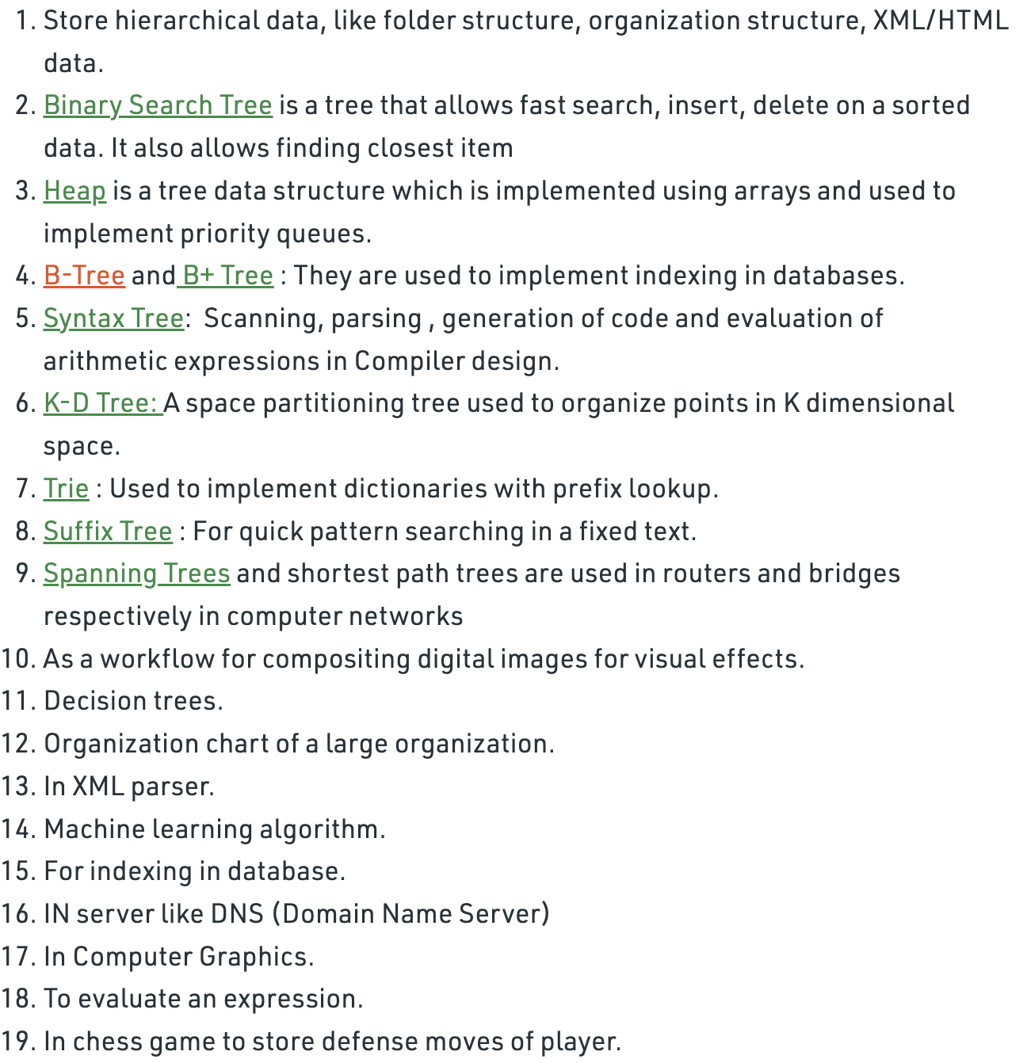
Applications of trees

